Slide 1



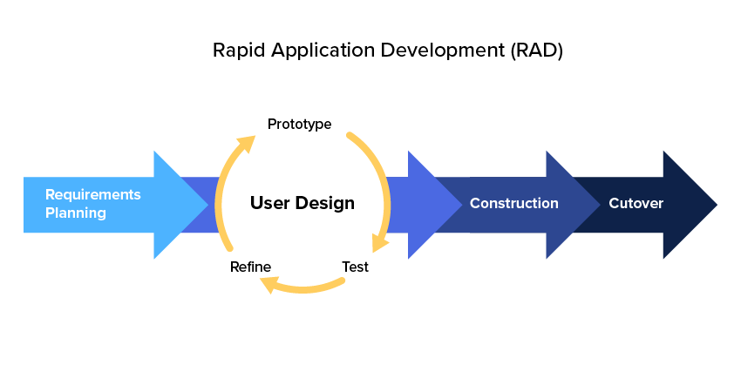



ARésumé: A Web-based Portfolio Resume Generator with Augmented Reality
Abstract
Analysis
Resume is an important tool for job seekers when it comes to job hunting. AResume, a web-based application is a typical resume generator that generates resume with augmented reality features. It is built for job applicants who have difficulty in creating a professional resume from scratch, as well as trying to attempt “one-size-fits-all” approach, which fits all information in a resume. In this application, a web augmented reality (AR) will be developed over mobile AR because of its lightweight approach, cross-platform support and no installation is necessary. The methodology of this project is Rapid Application Development, which it rapids the development process and allows bugs fixing to be done in parallel with the development. By using AResume, not only it will enable job applicants to create resume, upload digital medias as augmented features and scan the resume by using web browser, but also provides and enriches better user experience and interaction with resumes for hiring managers when reviewing resumes.
Aim & Objectives
The aim and objectives of this project is:
To develop a resume generator for job applicants to create resume online with AR technology
To study the comparison analysis of the existing similar applications
69% do not know how to present portfolio in a resume to impress hiring managers
Technologies
Methodology

Slide 2







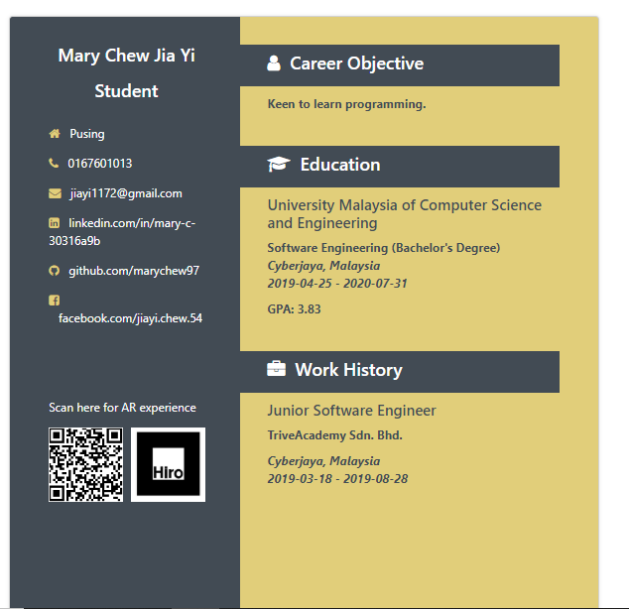
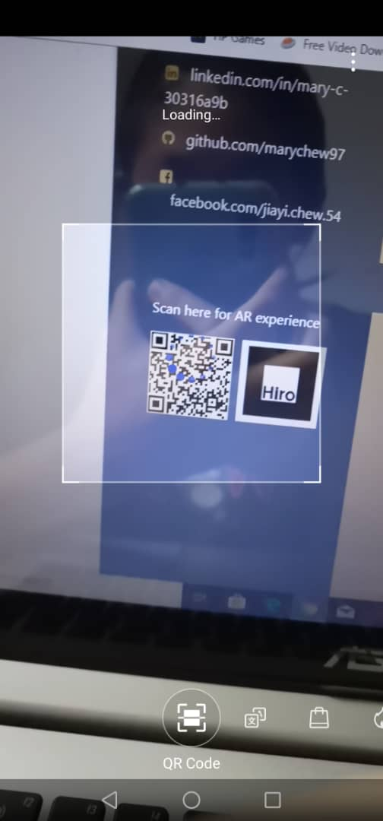
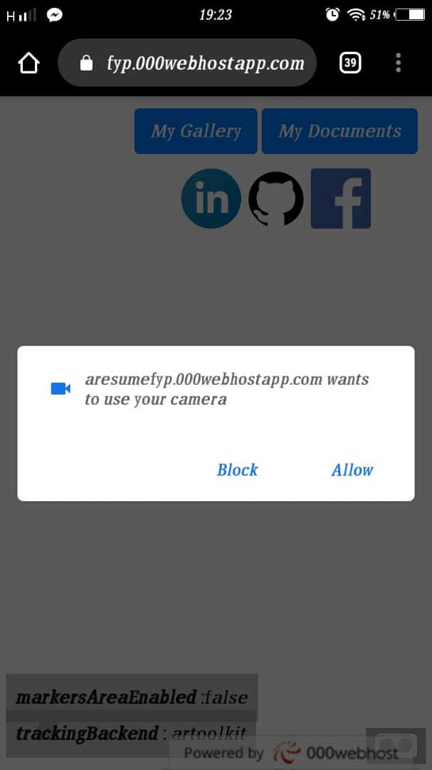
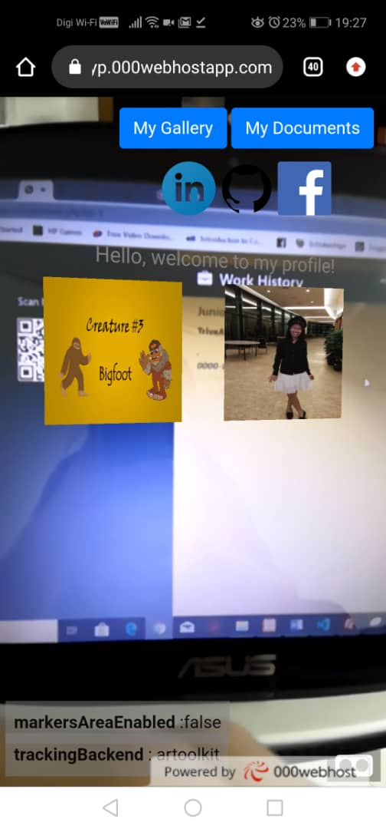
Comparison between existing applications
Features
Cross-platform support | x | x | x | √ | √ | √ | √
Web AR support | x | x | x | √ | √ | √ | √
Digital media upload | √ | x | √ | √ | √ | √ | √
Produce augmented contents | x | x | √ | √ | √ | √ | √
Marker-based support | x | x | x | √ | x | √ | √
Generate sharable URL | √ | x | √ | √ | √ | √ | √
Create augmented resume | x | x | x | x | x | x | √
Result
Revenue Model
Future Implementations
Free
Resume
All templates
PDF download
No AR features
$1
Resume
All templates
PDF download
AR features (Video, photos, documents)
Twice update of AR features for free
End Users
(Job Applicants)
Hiring Manager (Employers)
Choose field of interest
Upload Resume to database
Select & hunt for talent employees
View Resume
Team Members:
Mary Chew Jia Yi Quek Siang Yee Lim Yeu Jie
Faculty of Computing
Mentor: Dr. Ong Huey Fang

